Slide 1
An Audio Fingerprinting System for Live Version Identification using Image Processing Techniques
(Dr.?) Zafar Rafii
Northwestern University
EECS department

Slide 2
Acknowledgments
Work done during internship at Gracenote, a company doing audio and video identification, with co-authors Bob Coover and Jinyu Han.
Work presented at the 39th IEEE International Conference on Acoustics, Speech and Signal Processing, Florence, Italy, May 4-9, 2014.

Slide 3
Context
You are at a concert
You know the artist who is playing
You want to know about the song being played
You have a smart device (e.g., an iPhone)

Slide 4
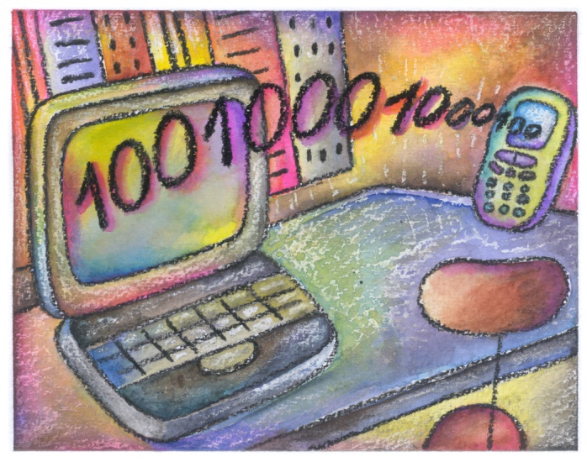
Idea
You can use a music identification system
You record an excerpt using your smart device
It is processed and compared against a database
You get information about the song (e.g., title)

Slide 5
Principle
Audio fingerprinting systems
Transform the audio into a compact fingerprint
Compare the query against a database for a match
Typically index fingerprints to speed up matching

Slide 6
Limitations
Does not work with cover versions (e.g., live)
Variations in tempo (e.g., faster renditions)
Variations in key (e.g., higher pitch)
Variations in instrumentations, etc.

Slide 7
Solution
A novel system that can handle
Short excerpt quickly (i.e., less than 10 seconds)
Audio degradations (e.g., noise, encoding, etc.)
Audio variations (e.g., different tempo, key, etc.)

Slide 8
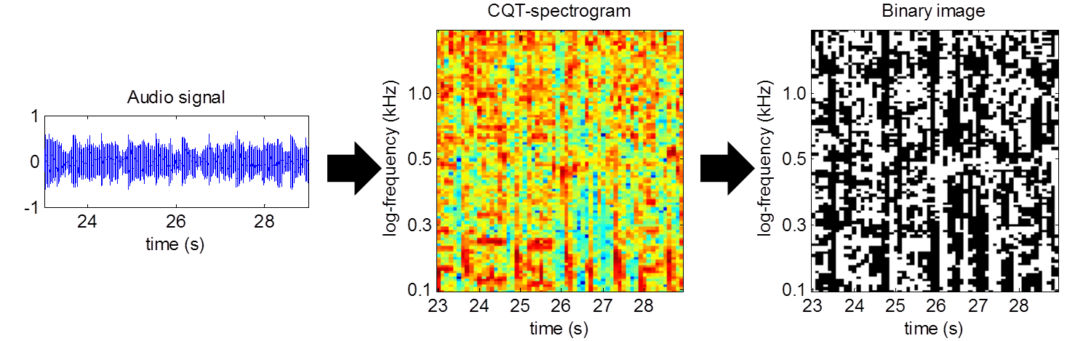
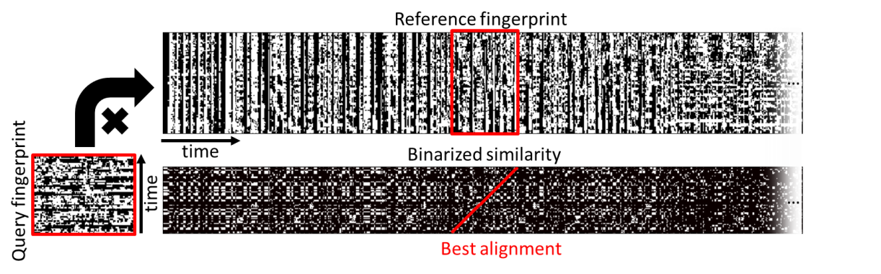
Approach
Fingerprinting stage
Constant Q Transform
Adaptive thresholding
Matching stage
Hamming similarity
Hough Transform

Slide 9
Fingerprinting
Constant Q Transform (CQT)
We first transform the audio signal into a time-frequency representation using the CQT
Time window centered at
24 seconds
Time frame centered at
24 seconds

Slide 10
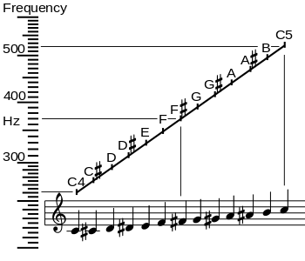
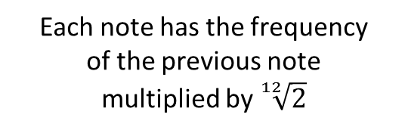
Fingerprinting
Constant Q Transform (CQT)
The CQT has a log-frequency resolution, matching the notes of the chromatic scale (i.e., C, C#, etc.)
Each note has the frequency
of the previous note
multiplied by $\sqrt[12]{2}$
Logarithmic frequency resolution
http://en.wikipedia.org/wiki/Note

Slide 11
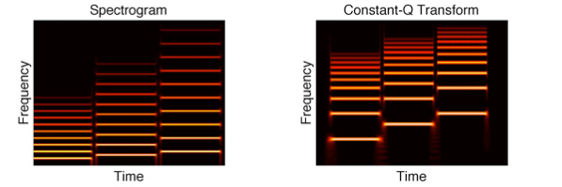
Fingerprinting
Constant Q Transform (CQT)
Unlike the FT, the CQT is more compact and better adapted to music (vertical shift = pitch shift)
Three notes played at different pitches in
the FT-spectrogram (left) and the CQT-spectrogram (right)
Linear frequency resolution
Logarithmic frequency resolution
https://ccrma.stanford.edu/~gautham/

Slide 12
Fingerprinting
Adaptive thresholding
We transform the CQT-spectrogram into a binary image using an adaptive thresholding method

Slide 13
Fingerprinting
Adaptive thresholding
For each bin in the spectrogram, we assign 1 if the bin is higher than the median of the neighborhood
Neighborhood
at 27 seconds
and C6 (1.0 kHz)
Bin
at 27 seconds
and C6 (1.0 kHz)
< than median
0
1
Bin
at 25 seconds
and C4 (262 Hz)
> than median
Neighborhood
at 25 seconds
and C4 (262 Hz)

Slide 14
Fingerprinting
Adaptive thresholding
We get a fingerprint that reduces the spectrogram into 2 components, of locally low and high energy
+ energy
- energy
+ energy
- energy

Slide 15
Approach
Fingerprinting stage
Constant Q Transform
Adaptive thresholding
Matching stage
Hamming similarity
Hough Transform

Slide 16
Matching
Hamming similarity
We then compute a similarity matrix between the fingerprints of a query and each of the references
Reference fingerprint
Matrix
multiplication
…
time
Similarity matrix
Query fingerprint
time
…
+ match
- match

Slide 17
Matching
Hamming similarity
We use the Hamming similarity between all pairs of time frames (= percentage of bins that match)
Reference fingerprint
Matrix
multiplication
…
time
Similarity matrix
Query fingerprint
time
…
Similarity between the time frames of the query and the reference
+ match
- match

Slide 18
Matching
Hamming similarity
We compute the similarity matrix for different pitch shifts between the query and the references
Reference fingerprint
Matrix
multiplication
…
time
Similarity matrix
Query fingerprint
time
…
Pitch shift down, one semitone
+ match
- match

Slide 19
Matching
Hough Transform (HT)
We binarize the similarity matrix via a threshold to have pairs of time frames that match (1) or not (0)
Reference fingerprint
…
time
Binarized similarity
Query fingerprint
time
…
match
no match

Slide 20
Method
Hough Transform (HT)
We use the HT to identify the best alignment between the query and the reference fingerprints
Reference fingerprint
…
time
Binarized similarity
Query fingerprint
time
…
Best alignment: 64% of time
frames matching
match
no match

Slide 21
Matching
Hough Transform (HT)
The HT helps to take into account potential tempo deviations, by trying different angles for a line
Reference fingerprint
…
time
Binarized similarity
Query fingerprint
time
…
Angle of 41°:
query faster
than reference
Angle of 45°:
query as fast
as reference
Angle of 47°:
query slower
than reference
match
no match

Slide 22
Evaluation
References
10 different artists of varied genres
389 full tracks from studio albums
Durations from 01’04’’ to 11’06’’
Queries
87 full tracks from live albums (experiment 1)
87 audio tracks from smart devices (experiment 2)
10 queries per tracks, 6 and 9 second length

Slide 23
Data set
artist | genre | #references | #queries
AC/DC | hard rock | 36 | 60
Arcade Fire | indie rock | 33 | 100
Bonobo | electronic | 42 | 100
Eagles | rock | 32 | 90
Foreigner | rock | 29 | 100
Jefferson Airplane | psychedelic rock | 65 | 40
Led Zeppelin | rock | 40 | 80
Phoenix | alternative rock | 38 | 100
Portishead | electronic | 33 | 100
Suprême NTM | French hip hop | 41 | 100
all | - | 389 | 870

Slide 24
Live albums (9 seconds)
Top-k matches | k=1 | k=2 | k=3 | k=4 | k=5
AC/DC | 0.92 | 0.95 | 0.97 | 0.97 | 0.97
Arcade Fire | 0.84 | 0.92 | 0.94 | 0.96 | 0.97
Bonobo | 0.83 | 0.89 | 0.92 | 0.92 | 0.96
Eagles | 0.93 | 0.97 | 0.98 | 0.99 | 0.99
Foreigner | 0.88 | 0.93 | 0.93 | 0.95 | 0.97
Jefferson Airplane | 0.60 | 0.68 | 0.78 | 0.78 | 0.80
Led Zeppelin | 0.74 | 0.81 | 0.84 | 0.85 | 0.90
Phoenix | 0.88 | 0.92 | 0.93 | 0.97 | 0.98
Portishead | 0.92 | 0.93 | 0.93 | 0.93 | 0.93
Suprême NTM | 0.87 | 0.95 | 0.96 | 0.97 | 0.97
all | 0.86 | 0.91 | 0.92 | 0.94 | 0.95

Slide 25
Smart devices (9 seconds)
Top-k matches | k=1 | k=2 | k=3 | k=4 | k=5
AC/DC | 0.70 | 0.83 | 0.85 | 0.87 | 0.93
Arcade Fire | 0.79 | 0.86 | 0.89 | 0.91 | 0.93
Bonobo | 0.60 | 0.75 | 0.83 | 0.89 | 0.93
Eagles | 0.70 | 0.77 | 0.88 | 0.91 | 0.91
Foreigner | 0.68 | 0.83 | 0.86 | 0.86 | 0.88
Jefferson Airplane | 0.40 | 0.53 | 0.55 | 0.60 | 0.63
Led Zeppelin | 0.28 | 0.39 | 0.48 | 0.53 | 0.54
Phoenix | 0.67 | 0.76 | 0.82 | 0.86 | 0.87
Portishead | 0.80 | 0.86 | 0.87 | 0.87 | 0.87
Suprême NTM | 0.30 | 0.42 | 0.45 | 0.51 | 0.55
all | 0.61 | 0.71 | 0.76 | 0.79 | 0.81

